Slide 1

My homie
Smart Home Dashboard: Voice-Controlled Automation
By salma ashraf , Maryam milad & reem el mohandes

Slide 2



Global technology
Smart Product
Voice control
Artificial Intelligence

Slide 3
The Future of Home Control is Here
Increasing demand for smart home solutions.
Need for intuitive and accessible control interfaces.
Project goal: Develop a voice-controlled smart home dashboard.
Focus on user experience and seamless integration

Slide 4
Network Technology
Problem Solving
Algorithm
Automation

Slide 5
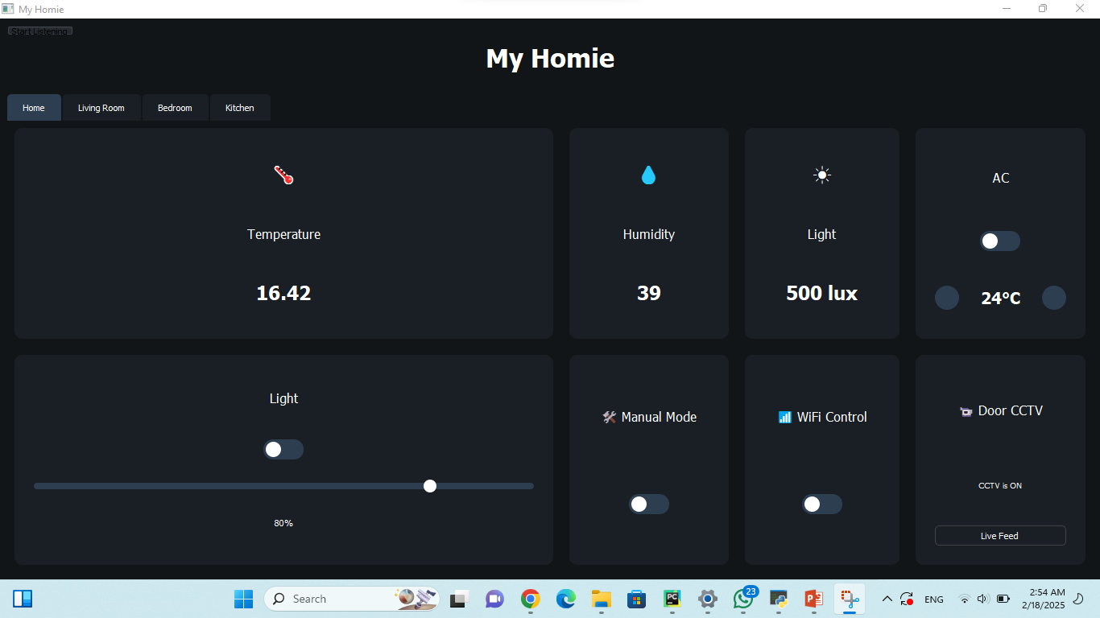

Slide 6
A Centralized Control Hub
Key Features:
Voice control using Whisper for speech recognition.
Real-time device status monitoring.
Customizable room layouts and controls.
Integration with weather API for environmental data.
CCTV integration for home security.

Slide 7
Building the Smart Home Ecosystem
Programming Language: Python with PyQt5 for GUI.
Voice Recognition: Whisper for accurate speech-to-text.
Hardware Interface: Sounddevice for audio recording.
Weather Data: OpenWeatherMap API integration.
CCTV Integration: OpenCV for camera access and display.
Device Control: Simulated device control using custom widgets (switches, sliders). (Mention potential for integration with actual IoT devices later).

Slide 8
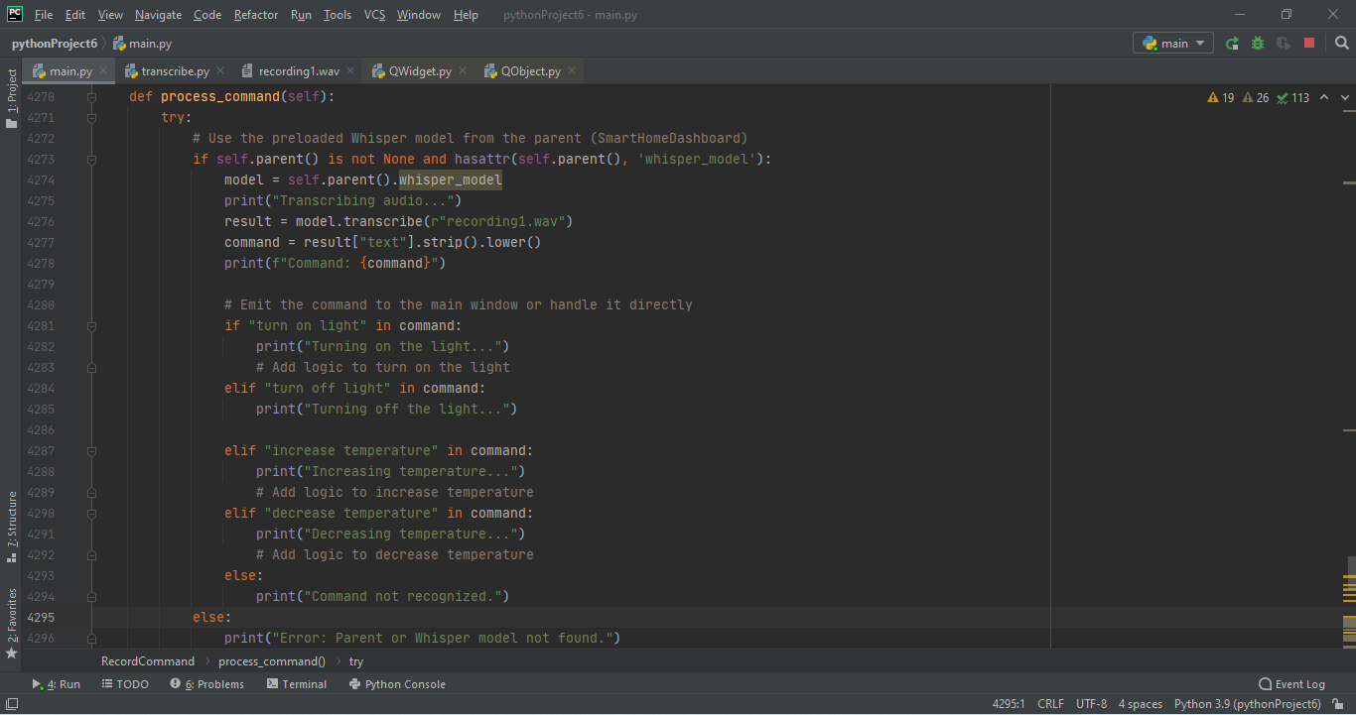

Slide 9
Key Features in Detail

Slide 10
1- Voice Control
Headline: Speak Your Commands
Description: Users can control devices using natural language commands. Whisper model provides robust speech recognition.
Example Commands: "Turn on the living room light," "Increase the bedroom temperature," "Show me the front door camera."

Slide 11
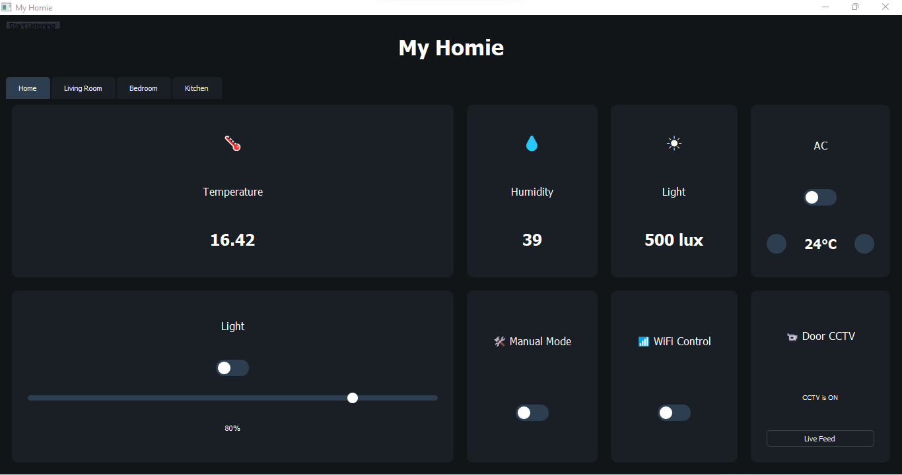
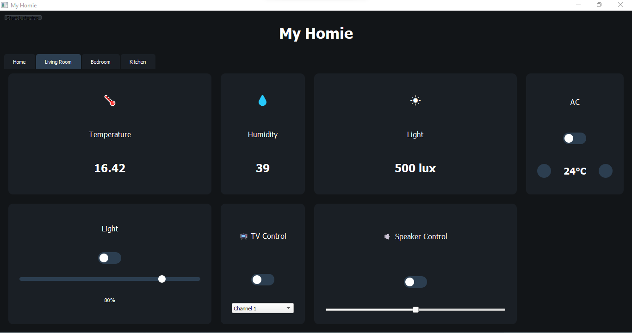
2- Dashboard Interface
Headline: Intuitive and Informative
Description: The dashboard provides a clear overview of the home environment. Real-time status updates for all connected devices. Customizable room layouts for personalized control.

Slide 12
3 - Weather and CCTV
Headline: Stay Informed and Secure
Weather: Integration with OpenWeatherMap API provides current temperature, humidity, and other weather data.
CCTV: Live video feed from connected cameras for home monitoring. (Mention potential for facial recognition or motion detection in future work).

Slide 13
Future Work

Slide 14
Building Raspberry pi image
Set up Build Environment: Install Yocto Project tools (Poky, bitbake, BSP). Source environment setup.
Choose Raspberry Pi BSP: Add meta-raspberrypi layer to bblayers.conf.
Create Custom Layer: Use yocto-layer create-layer to make a layer for your app. Add layer path to bblayers.conf.
Create Python App Recipe: a. Create your-app_%.bbappend (or .bb) file in your layer.
Define SUMMARY, SECTION, LICENSE, DEPENDS (including python3, python3-pip).
Set S = "${WORKDIR}/recipe-sysroot".
Define SRC_URI pointing to your app's files (e.g., file://my_script.py).
Implement do_install(): Install your Python script (using install, python setup.py install, or pip3 install).
Create a files directory in your layer and put your Python scripts there.
Add Image Features: Add package-management to IMAGE_FEATURES in your image recipe or local.conf.
Modify/Create Image Recipe: Add IMAGE_INSTALL += "your-app" to an image recipe
(e.g., core-image-minimal.bbappend).
Build Image: Run bitbake <your-image-name> (e.g., bitbake core-image-minimal).
Deploy Image: Flash the built .img file to your Raspberry Pi SD card.

Slide 15
Expanding the Horizon
IoT Device Integration: Connect to real smart home devices using APIs or protocols like MQTT.
Advanced Automation: Implement schedules, triggers, and more complex automation rules.
Mobile App Development: Create a mobile version of the dashboard for remote access.
Machine Learning: Integrate ML models for predictive maintenance or personalized recommendations.
Smart TV Integration: Control entertainment systems through the dashboard.

Slide 16
Conclusion

Slide 17
A Smarter Way to Live :
The Smart Home Dashboard provides a user-friendly and powerful way to manage a smart home. Voice control and centralized interface enhance convenience and comfort. The project lays a foundation for future expansion and integration with more advanced smart home technologies.

Slide 18
Q&A

Slide 19


Slide 20

Thank You!

